Slide 1
Reporting and Visualization Tools
Kerry Nakayama

Slide 2

Objectives
Visualization tools
Database and Schema setup
Tableau
Custom SQL
Extracts
Implementing a new plan
Reporting Schema
Connecting it all
DAGs

Slide 3






Visualization Tools

Slide 4

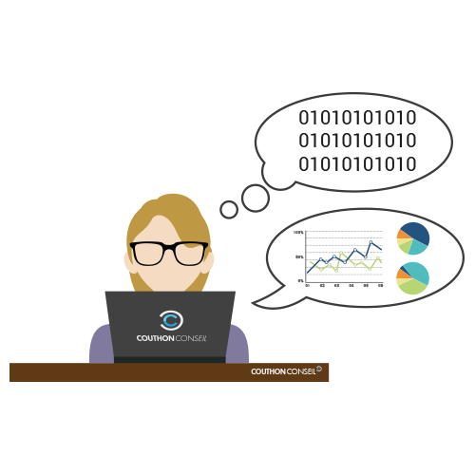
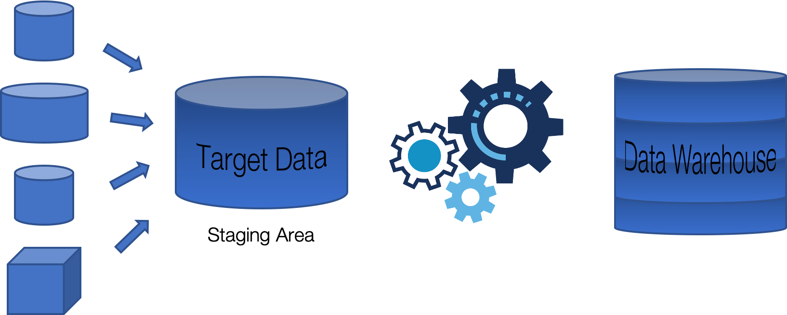

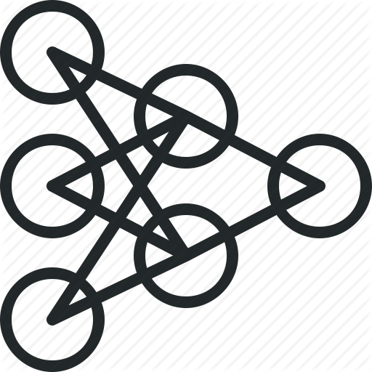
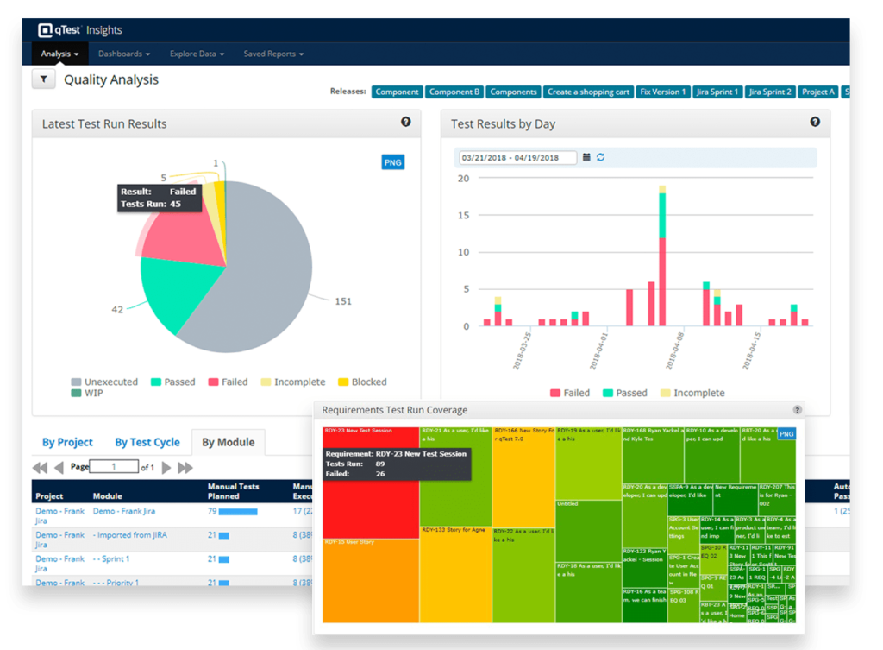
Database and Schema Setup
Reporting Schema

Slide 5
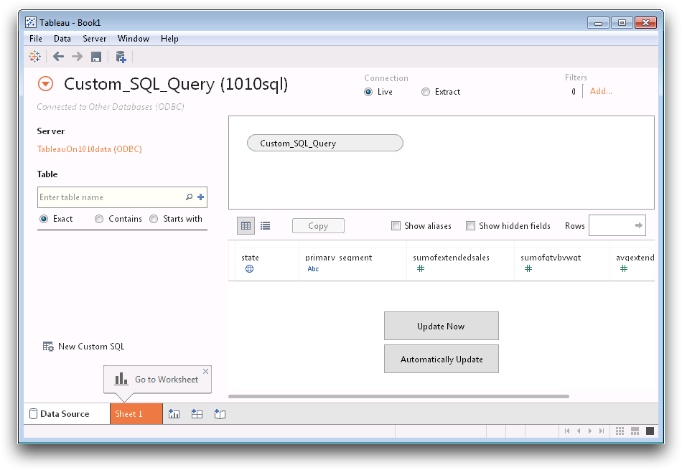
Tableau Custom SQL
Tableau allows you to connect any DB or Schema directly
Write custom SQL as if you are querying the DB directly
What could go wrong with this?
5
Notes:
Live connection
Every time a report is run it will have to run the query again…. So we have cached queries
What about filters when the user is changing a filter… no longer the same query
This can get very expensive depending on how active your tableau users are
If connecting to a huge table reports can take forever to run
Depending on how normalized the table is in prod you may need multiple connections to get the details that you need
Now connecting all these tables in tableau can take forever to run
This is problem I dealt with at many companies
Email the reports
So why not create an extract
Runs the code one time in the morning and creates an extract of the data… no longer have expensive queries running for all the people (could be hundreds)
New problem
No version control
In the notebook is deleted all the code is lost
No documentation
So how to fix this?/

Slide 6
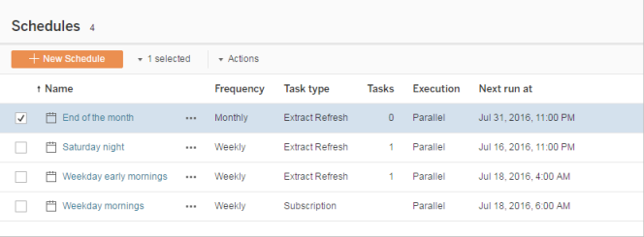
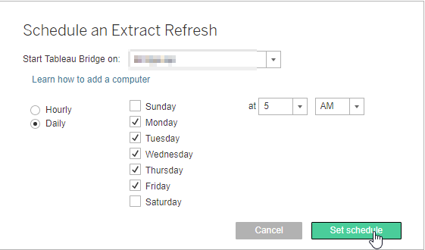
Extract Refresh Scheduler
Tableau allows you to schedule refreshes
Sending Reports through Tableau
Again What could go Wrong?
6
Notes:
Again major problem everything is still in tableau

Slide 7





Mini Breakout Lab
You are the Director of Business Intelligence
Create a plan…
How you would pull the custom SQL out of Tableau?
Where would you put it?
Would you keep live data or extracts?
Will you use any tools?
In a perfect world how would you control reports
7

Slide 8
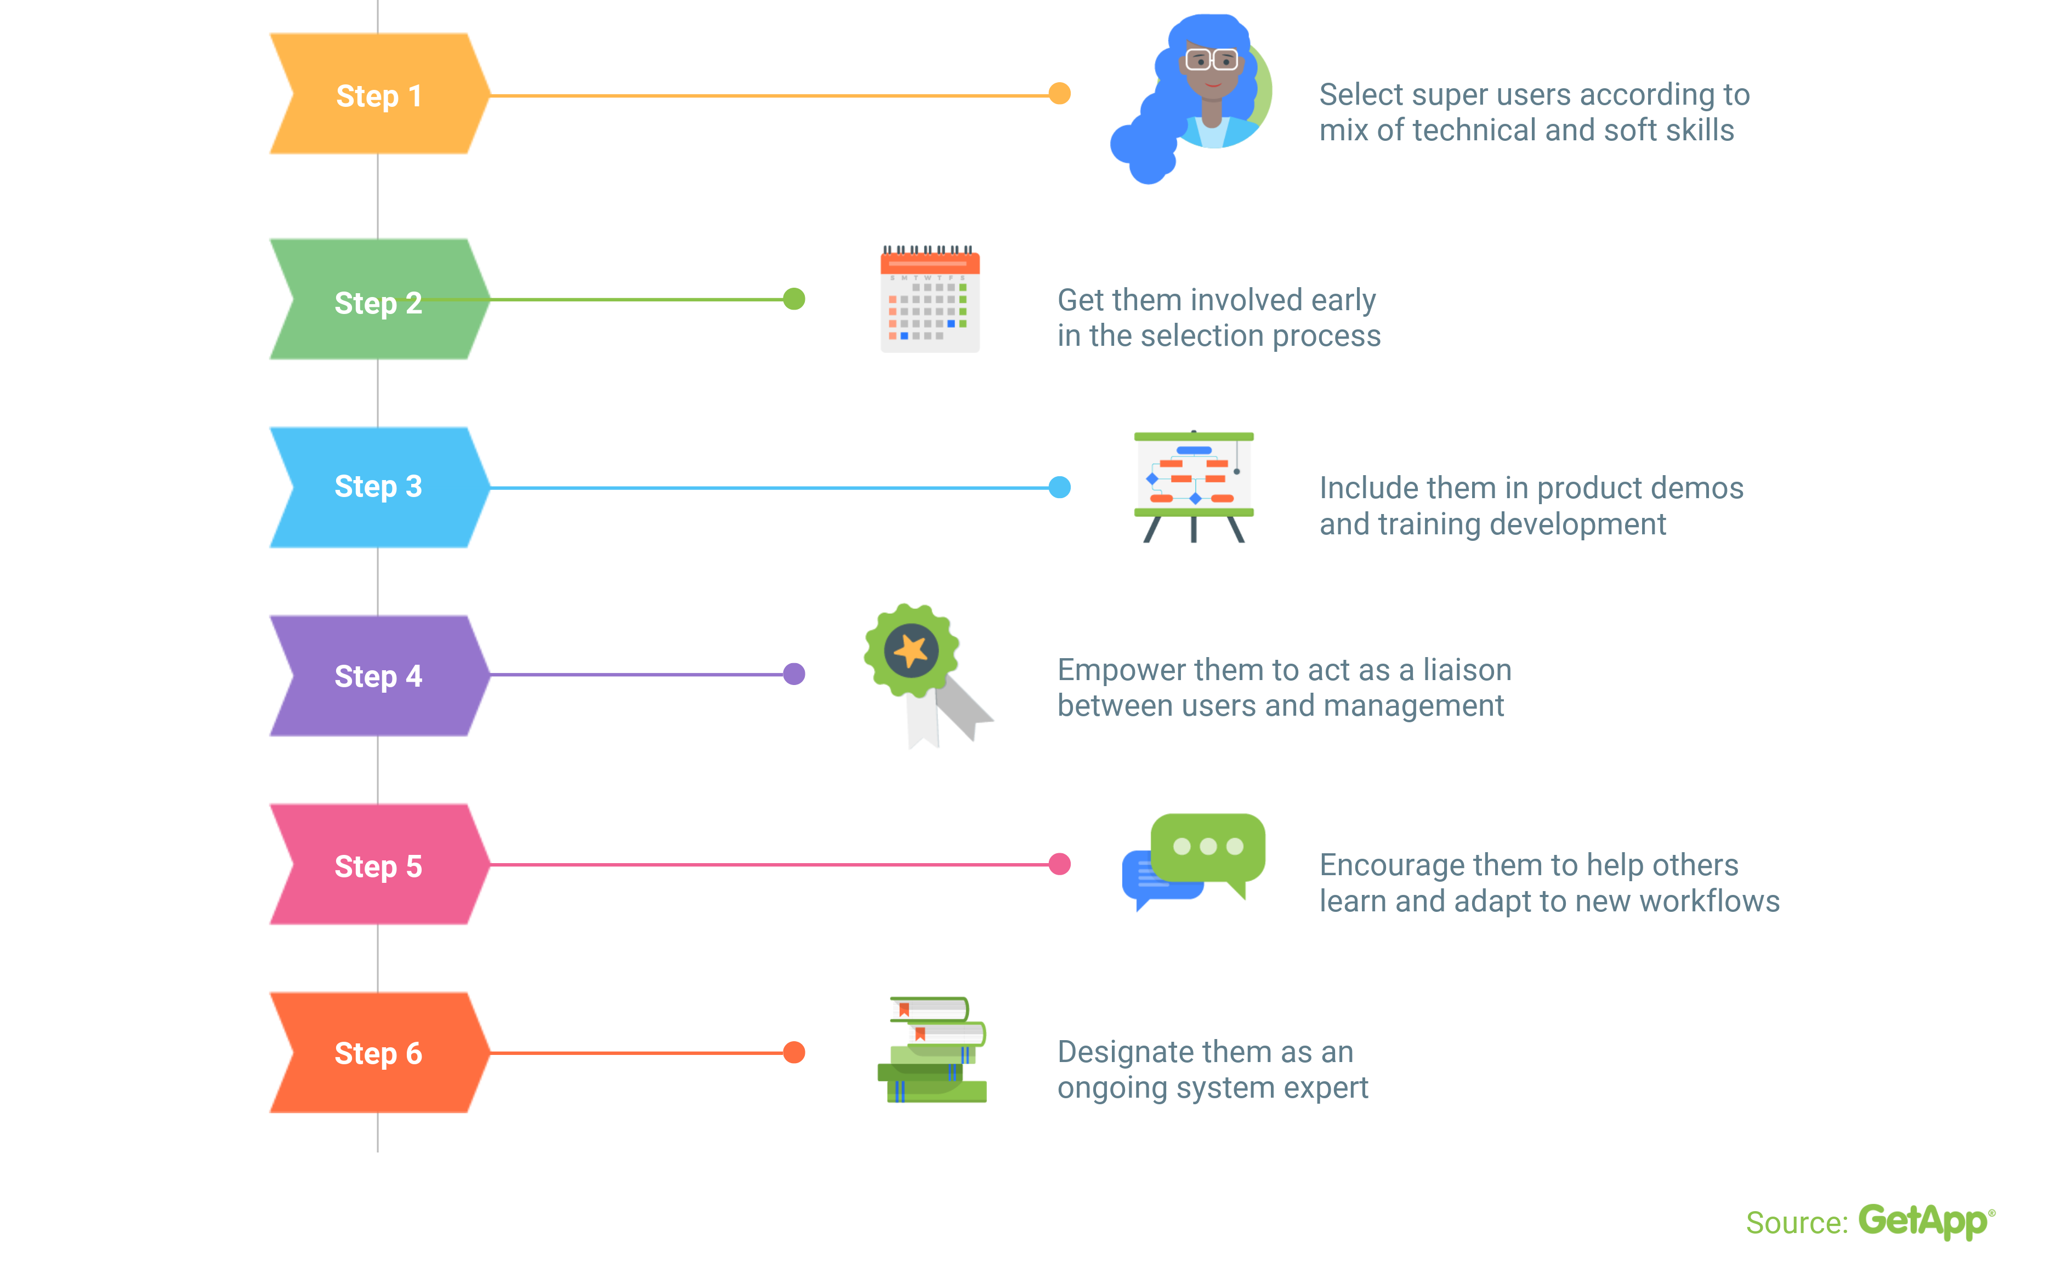
How to Implement a New Plan
Notes:
It needs to be a cultural change

Slide 9
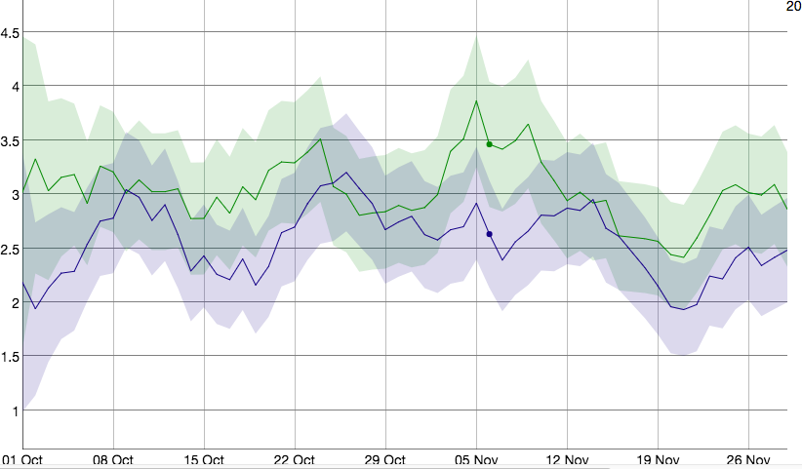
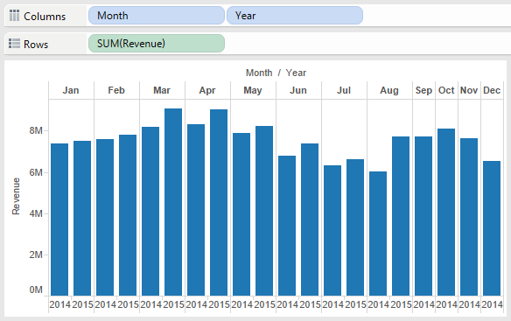
To Pre-cache or To Not Pre-cache?
When to use live data
Examples of live data
DAU
Tracking current event compared to plan
Fraud
When to pre-cache
Examples of cached data
Yesterdays numbers
MoM, WoW, DoD comparisons
Hitting plan
9

Slide 10




Reporting Schema
What is a Reporting Schema?
Pull the queries out of Tableau and into a repository
can help with this!
Schedulers
Reporting Schema
10

Slide 11
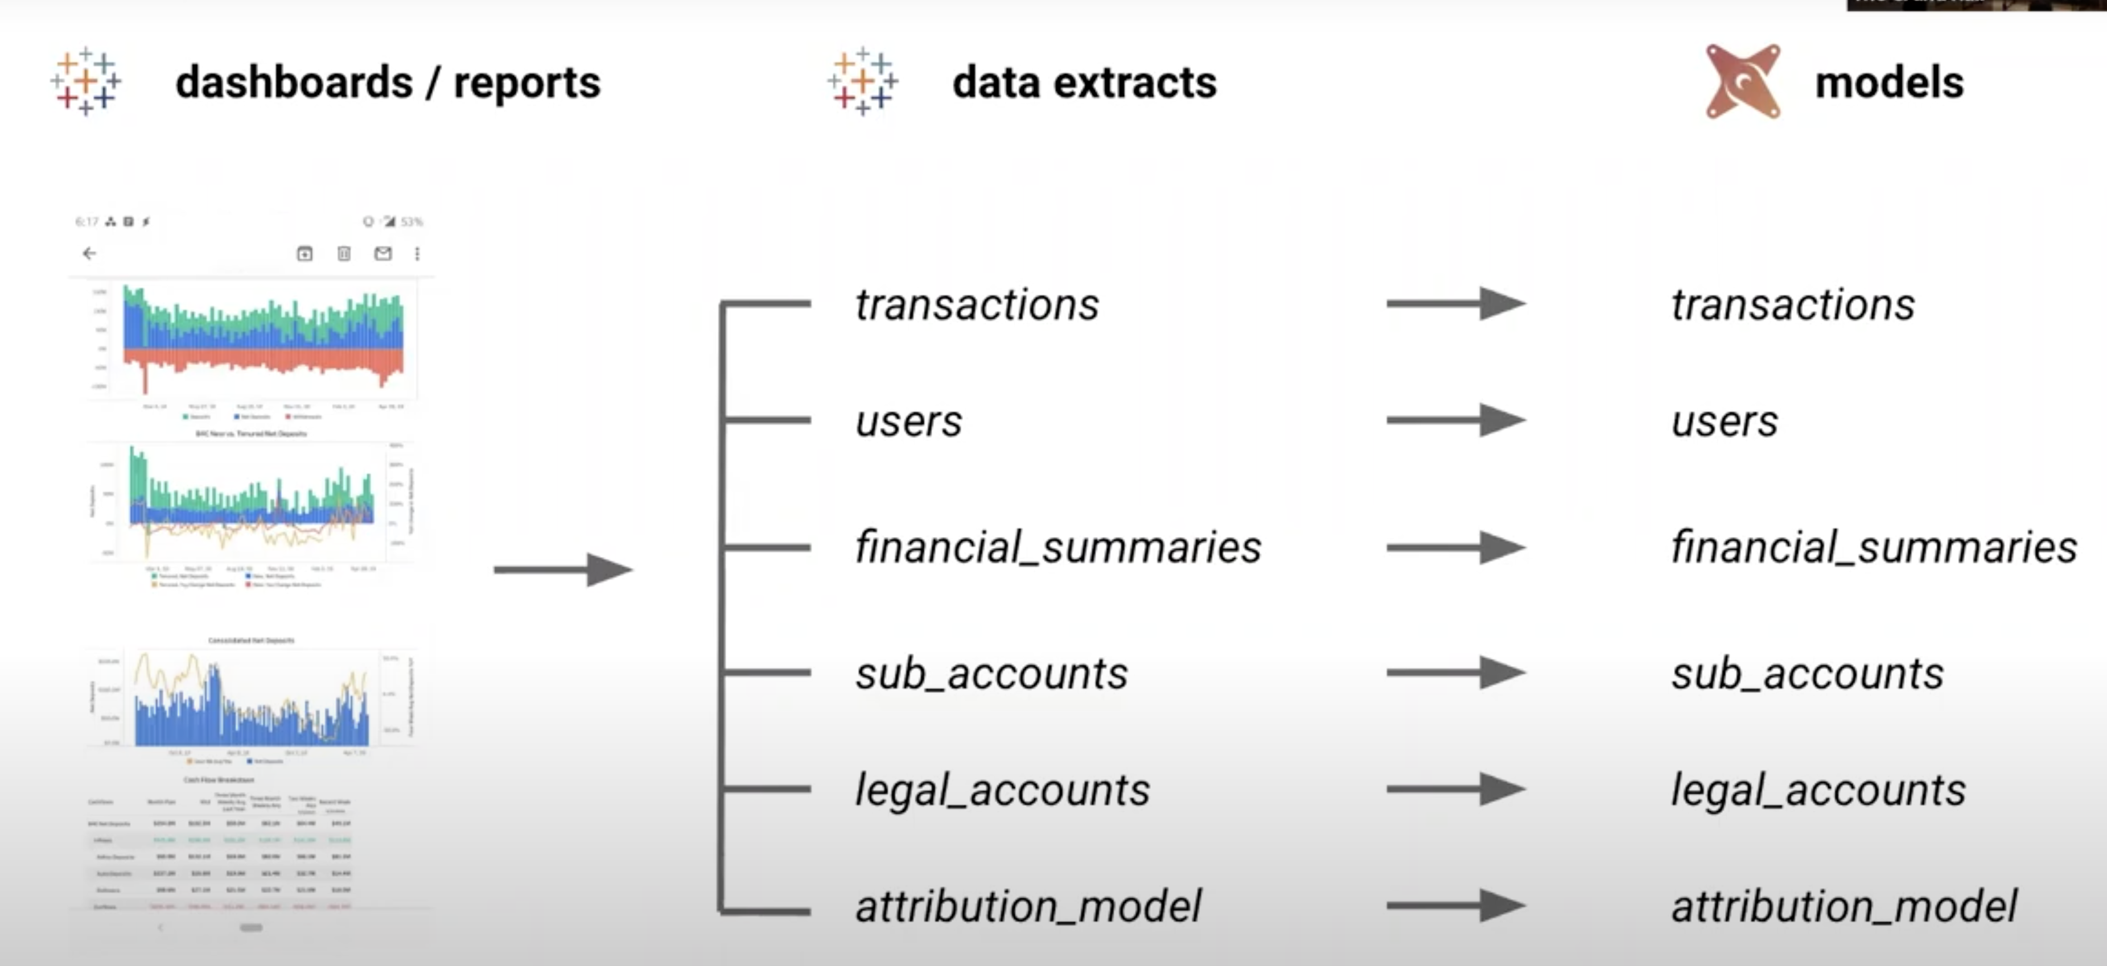
Connecting it all
Notes:
One to one model of extract to model

Slide 12
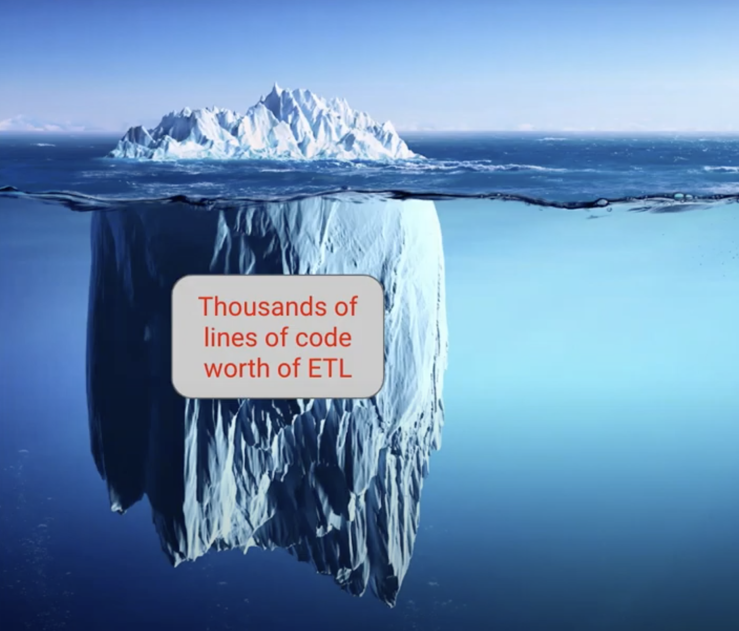
What’s Really Under the Hood

Slide 13
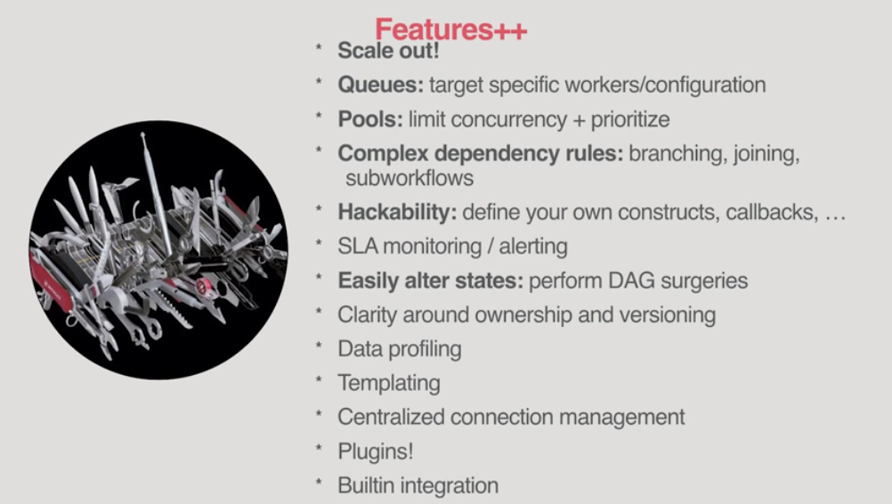
Scheduling all the Tasks
Chron tool on steroids
Removes bottle necks and issues when companies are large and have many pipelines
Based on data Swarm (FB)
Notes:
https://www.youtube.com/watch?v=dgaoqOZlvEA 420- 520
Code that instantiates pipelines 1125 – 1320 this with dbt
1920 sum priority weight
21 -

Slide 14
What is a DAG
Directed Acyclic Graph or a finite directed graph with no directed cycles
Collection of all the tasks you want to run, organized in a way that reflects their relationships and dependencies
Airflow is published as apache-airflow package in PyPI. Installing it however might be sometimes tricky because Airflow is a bit of both a library and application
Scheduler
Executor
Error Tracking
Notes:
https://www.youtube.com/watch?v=dgaoqOZlvEA 420- 520
Code that instantiates pipelines 1125 – 1320 this with dbt
Directed acyclic graph
A DAG is defined in a Python script, which represents the DAGs structure (tasks and their dependencies) as code.
For example, a simple DAG could consist of three tasks: A, B, and C. It could say that A has to run successfully before B can run, but C can run anytime. It could say that task A times out after 5 minutes, and B can be restarted up to 5 times in case it fails. It might also say that the workflow will run every night at 10pm, but shouldn’t start until a certain date.
In this way, a DAG describes how you want to carry out your workflow; but notice that we haven’t said anything about what we actually want to do! A, B, and C could be anything. Maybe A prepares data for B to analyze while C sends an email. Or perhaps A monitors your location so B can open your garage door while C turns on your house lights. The important thing is that the DAG isn’t concerned with what its constituent tasks do; its job is to make sure that whatever they do happens at the right time, or in the right order, or with the right handling of any unexpected issues.
Scheduler
The Airflow scheduler monitors all tasks and all DAGs and triggers the Task instances whose dependencies have been met. Behind the scenes, it spins up a subprocess, which monitors and stays in sync with a folder for all DAG objects it may contain, and periodically (every minute or so) collects DAG parsing results and inspects active tasks to see whether they can be triggered.
The Airflow scheduler is designed to run as a persistent service in an Airflow production environment. To kick it off, all you need to do is execute the airflow scheduler command. It uses the configuration specified in airflow.cfg.
The scheduler uses the configured Executor to run tasks that are ready.
To start a scheduler, simply run the command:
airflow scheduler
Your DAGs will start executing once the scheduler is running successfully.
Executors are the mechanism by which task instances get run.
Sequential Executor
Debug Executor
Local Executor
Dask Executor
Celery Executor
Kubernetes Executor
Scaling Out with Mesos

Slide 15
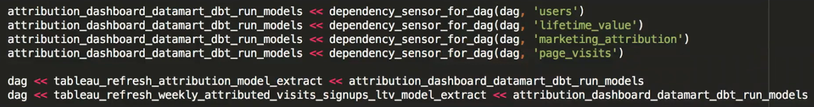
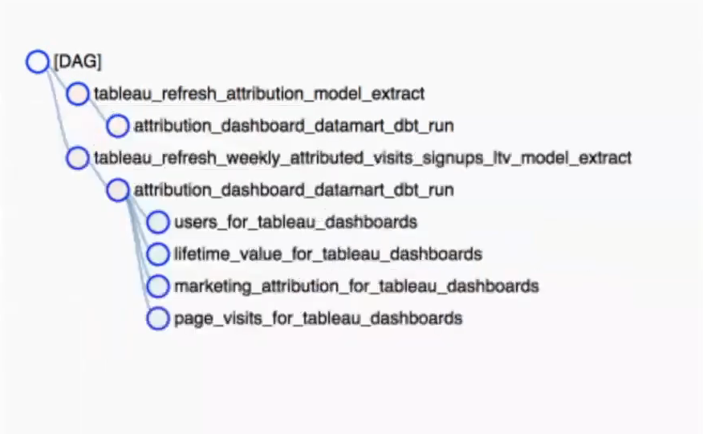
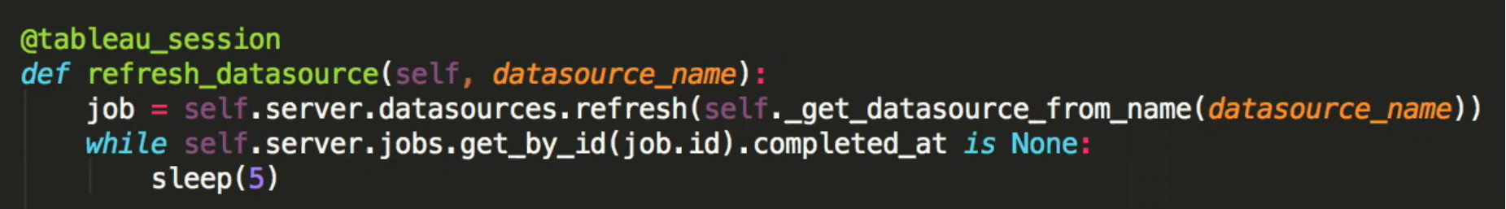
DAGs
Notes:
Directed acyclic graph –
How I worked with Airflow in the past
Went from a scheduler that was not visible to something I can monitor and set to rerun if there is a failure
Bread crumbs and error tracking

Slide 16

Optimizing Reporting Schema
Best Practices
Separate extracts for different date groupings
Limit the columns
Only run extracts when they need to be run
Make filters human readable
Limit functions in Tableau
Custom SQL should be Select * from Table with maybe a date filter
Performance tuning often
Test and iterate
16

Slide 17

Reporting Style Guide
Limit the number of views in a Dashboard
Encourage exploration through filters
Only show filters that are relevant
Use color and highlighting to emphasize the data
Don’t have the double scroll
Stay away from Fake Media Charts
Leverage the most viewed spots
MAKE REPORTS EASY TO UNDERSTAND IN UNDER 5 SECONDS
17

Slide 18

Confused? ASK QUESTIONS

Slide 19
Break & Lab 9
Notes:
DBT working session

